Slide 1

Session-2

Slide 2
Content
Code Sharing Strategy
Application Class
App.Xaml File
App.Xaml.cs File
App Lifecycle

Slide 3
Code Sharing Strategy
Shared Project
Portable Class Library
.Net Standard

Slide 4
Shared Project
Shared between multiple target projects
Support compiler directives which enables the user to conditionally include platform-specific code

Slide 5
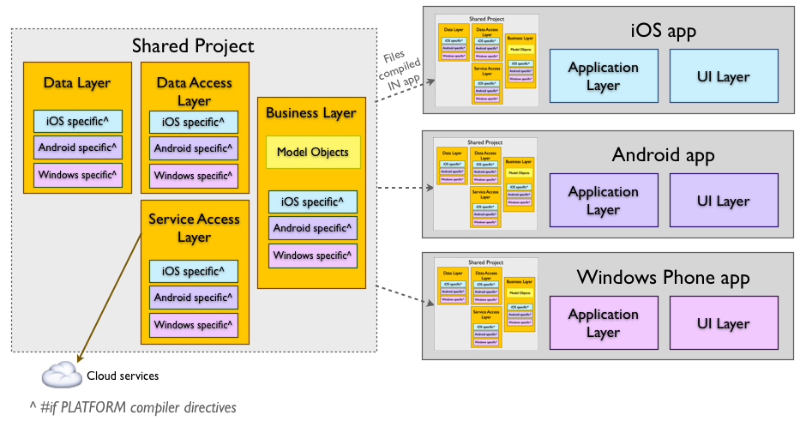

Slide 6
PCL
PCL projects target specific profiles that support a known set of BCL classes/features.
Why PCL ? - choose a combination of platforms
Centralized code sharing – write and test code in a single project that can be consumed by other libraries or applications.
Refactoring operations will affect all code loaded in the solution (the Portable Class Library and the platform-specific projects).
The PCL project can be easily referenced by other projects in a solution, or the output assembly can be shared for others to reference in their solutions.

Slide 7
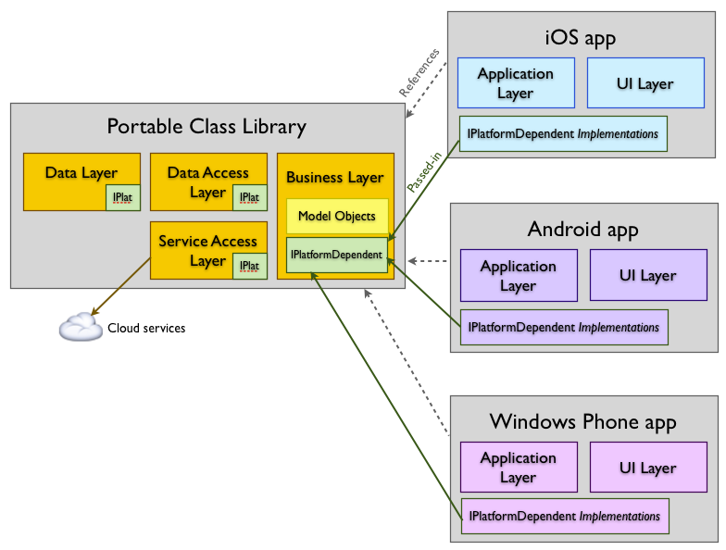

Slide 8
Application Class
Responsible for instantiating the first Page that will be displayed on the screen
InitializeComponent() - to load and parse the associated XAML.
App Class Properties
MainPage - to set the initial page for the app.
Current - reference to the current application object.
Properties dictionary to store simple values across lifecycle state changes

Slide 9
Properties Dictionary
The Application subclass has a static Properties dictionary which can be used to store data, in particular for use in the OnStart, OnSleep, and OnResume methods
The Properties dictionary uses a string key and stores an object value.
Application.Current.Properties ["id"] = someClass.ID;
SavePropertiesAsync() - which can be called to proactively persist the Properties dictionary.

Slide 10
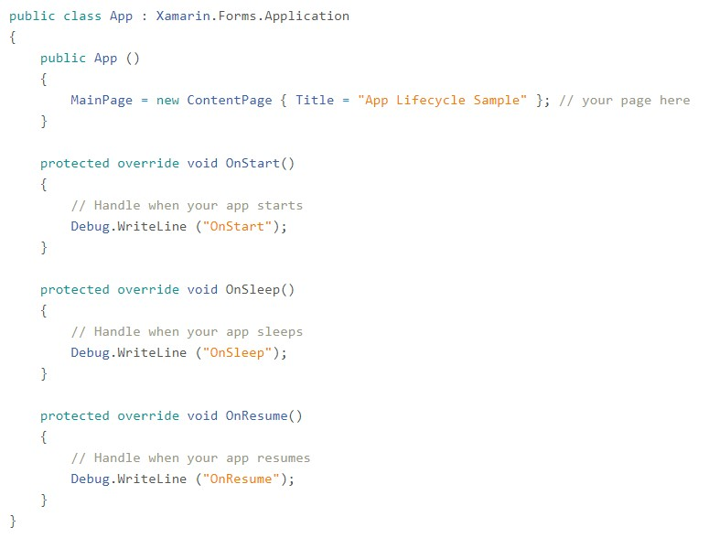

Slide 11
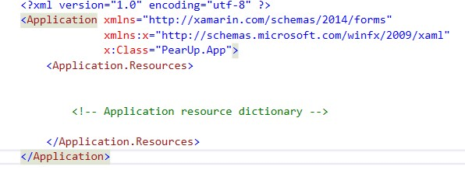
App.Xaml File

Slide 12
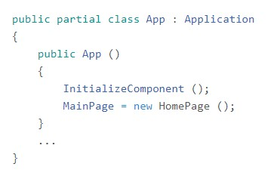
App.Xaml.cs File

Slide 13
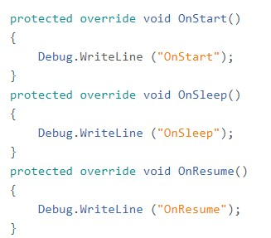
App Lifecycle
OnStart - Called when the application starts.
OnSleep - Called each time the application goes to the background.
OnResume - Called when the application is resumed, after being sent to the background
Note that there is no method for application termination

Slide 14
Modal Navigation Events
There are four new events on the Application class : ModalPushing - ModalPushingEventArgs ModalPushed - ModalPushedEventArgs ModalPopping - the ModalPoppingEventArgs class contains a Cancel property. When Cancel is set to true the modal pop is cancelled. ModalPopped - ModalPoppedEventArgs

Slide 15
Introduction to Xaml
XAML is a declarative markup language
Used to define user interfaces
UI is defined in an XML file using the XAML syntax
Well suited for use with Model-View-ViewModel (MVVM) application architecture
XAML defines the View that is linked to ViewModel code through XAML-based data bindings
XAML is basically XML, but XAML has some unique syntax features. The most important are:
Property elements
Attached properties
Markup extensions

Slide 16
Pros
Cons
XAML is often more succinct and readable than equivalent code
Greater visual clarity the parent-child hierarchy of user-interface objects.
XAML can be easily hand-written by programmers, but also lends itself to be toolable and generated by visual design tools
XAML cannot contain code.
All event handlers must be defined in a code file
XAML cannot contain loops for repetitive processing.(Except ListView)
XAML cannot contain conditional processing
XAML generally cannot instantiate classes that do not define a parameterless constructor
XAML generally cannot call methods.

Slide 17
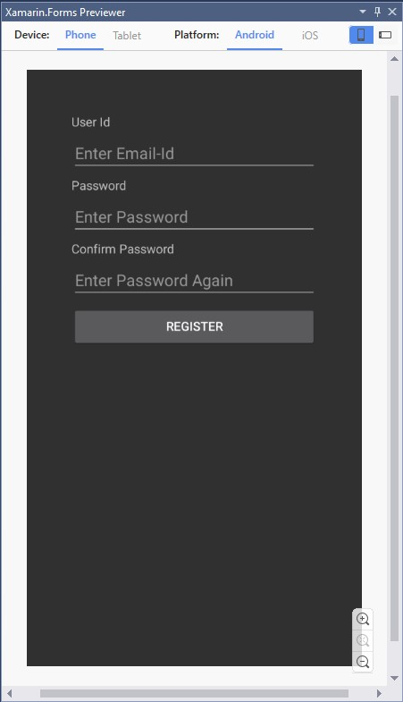
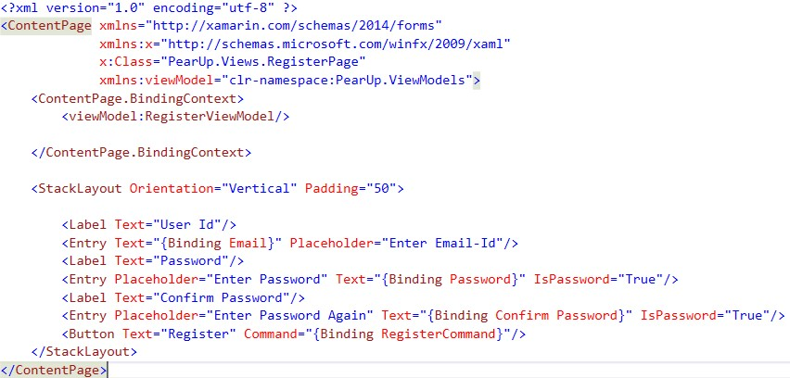
Xaml Previewer
Use the View > Other Windows > Xamarin.Forms Previewer menu in Visual Studio to open the preview window

